Slide 1
Regular Expression

Slide 2
Final Topics
Regular Expression, RegEx to NFA (Quiz-1)
NFA to DFA (assignment)
Parsing, Type of Parsing, First & Follow
Parsing Table (Quiz-2)
LL(1), LR Parser
Review

Slide 3
Course Evaluation
Final Term Evaluation
SL | Criteria | Percentage
 | Regular Week Criteria
1. | Attendance | 10%
2. | Performance | 10%
3. | Quiz (best 1 out of 2) | 20%
4. | Lab Performance (Lab Task and Lab Assignment) | 10%
 | Final Assessment Week Criteria
5. | Assignment (theory) | 10%
6. | MCQ based online Final Exam (theory final syllabus) | 10%
7. | MCQ based online Lab Performance | 10%
8. | Online Oral Viva (theory final syllabus + theory mid/final-assignments) | 20%
 | Total: | 100%
Total Grade = 40% of Mid Assessment + 60% of Final Assessment

Slide 4
Regular Expression
Regular expressions have the capability to express finite languages by defining a pattern for finite strings of symbols. The grammar defined by regular expressions is known as regular grammar. The language defined by regular grammar is known as regular language.

Slide 5
Regular Expression Application
The lexical analyzer needs to scan and identify only a finite set of valid string/token/lexeme that belong to the language in hand. It searches for the pattern defined by the language rules.
Regular expression is an important notation for specifying patterns. Each pattern matches a set of strings, so regular expressions serve as names for a set of strings.
Programming language tokens can be described by regular languages. Regular languages are easy to understand and have efficient implementation.
There are a number of algebraic laws that are obeyed by regular expressions, which can be used to manipulate regular expressions into equivalent forms.

Slide 6
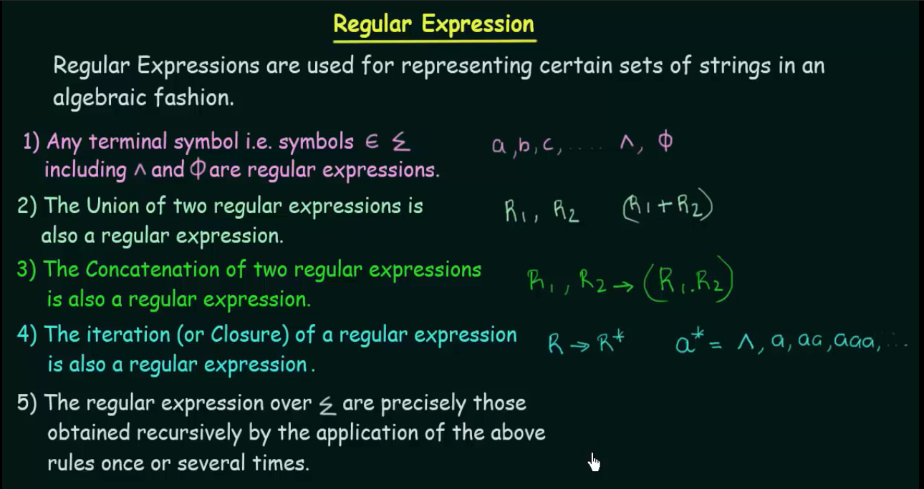

Slide 7
‘a' has length 2 = (a)² = aa
‘a' has length 1 = (a)¹ = a
‘a' has length 0 = (a)⁰ = ɛ
‘1’ can appear maximum 3 times = 111, 11, 1, ɛ

Slide 8
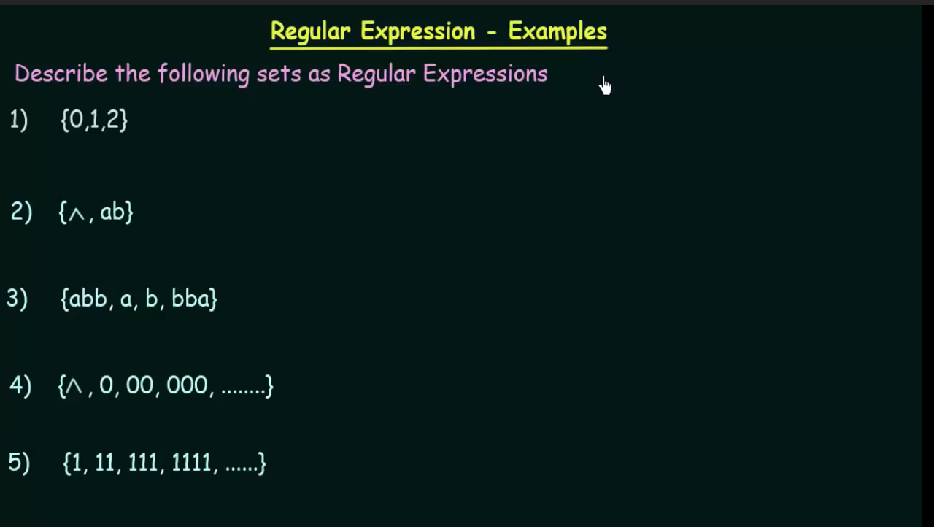
1) L = {0,1,2}
R = 0 + 1 + 2
2) L = {ɛ, ab}
ans1: R1 = ɛ + ab
3) L = {abb, a, b, bba}
Ans1: R1 = abb+a+b+bba
Ans2: R2 = a+b
4) L = {ɛ, 0, 00, 000, ….}
R = 0*
5) L = {1, 11, 111, ………….}
R1 =1⁺

Slide 9
Regular Expression Operators
Kleen closure (*) : e.g. (a)*
Meaning: the length of ‘a’ can start from 0 and it can be increased to infinity.
a* = {ɛ, a, aa, aaa, ……}
[that means,
when the length of ‘a’ is 0 we get ɛ (empty string)
when the length of ‘a’ is 1 we get ‘a’
when the length of ‘a’ is 2 we get ‘aa’
And so on….
]

Slide 10
Regular Expression Operators
2. Positive closure (+) : e.g. a⁺
Meaning: the length of ‘a’ can start from 1 and it can be increased to infinity.
a⁺ = {a, aa, aaa, ……}
[that means,
when the length of a is 1 we get a
when the length of a is 2 we get aa
And so on….
]
L = {ab, abab, ababab,….}
R = ab.(ab)⁺

Slide 11
Regular Expression Operators
3. Concatenation (.) : e.g. (a.b)
Meaning: in the language there will be a substring like “ab”
Output: ab
e.g. aabbddcd (here, bbbbaa is not allowed)
That means, change of ordering is not allowed in the concatenation operator.
R = abc.adc
Output: abcadc

Slide 12
4. Union Operator (+) : e.g. (a+b)
Meaning: we can take either a or b
R = (a+b)²
Output: aa, ab, ba, bb

Slide 13
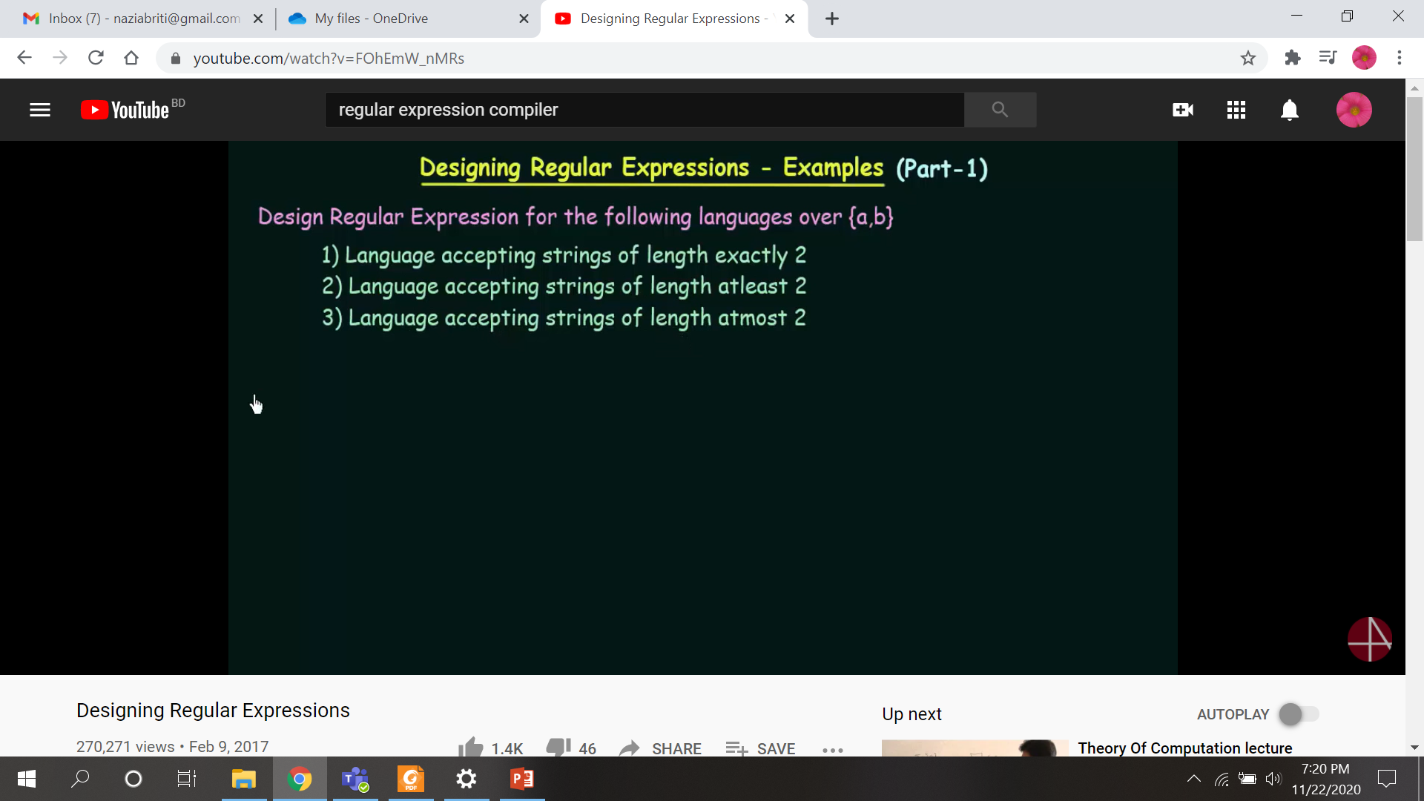
3) R = (ɛ+a+b)³
Output: aa, ab, ba, bb, aɛ, bɛ, ɛa, ɛb, ɛɛ
Output: aa, ab, ba, bb, a, b, ɛ

Slide 14
Question-1: Language accepting string of length exactly 5
Alphabet: {a,b,c}
Answer-1:
R = (a+b+c)⁵
Question-2: Language accepting string of length exactly 2
Alphabet: {a,b,c,d,e}
Answer-2:
R = (a+b+c+d+e)²
Question-3: Language accepting string of character ‘a’ and ‘e’ and length exactly 5
Alphabet: {a,b,c,d,e}
Answer-3:
R = (a+e)⁵
Question-4: Language accepting string of length exactly 5
Alphabet: {a,b,c,d,e}
Answer-4:
R = (a+b+c+d+e)⁵

Slide 15
Question-2: Language accepting string of length atleast 2
Alphabet: {a,b}
Atmost 2 ??
aa, ab, ba, bb, a, b, ɛ
R = (ɛ+a+b)²
Output: aa, ab, ba, bb, ɛa, ɛb, aɛ,
bɛ, ɛɛ
=> aa, ab, ba, bb, a, b, ɛ
R1 = (a+b)² . (a+b)*
R2 = (a+b) . (a+b)⁺
Output: ab, abb

Slide 16
Question-3: Language accepting string of length atmost 2
Alphabet: {a,b}
Answer:
Question-3: Language accepting string of length atmost 5
Alphabet: {a,b,c,d}
Answer:
R = (ɛ+a+b+c+d)⁵
e.g. ɛɛɛab = ab
R = (ɛ+a+b)²
E.g. ɛɛ, ɛa, ɛb, aɛ, bɛ, aa, ab, ba, bb
=> ɛ, a, b, aa, ab, ba, bb

Slide 17
Construct a Regular Expression for following language where alphabet is {0, 1}.
where, language={w | w starts with a 0 and contain the 1011 as substring}
R = 0.(0+1)*.1011.(0+1)*
Output: 01011, 011111011, 0110110111111

Slide 18
Construct a Regular Expression for following languages where alphabet is {0, 1}.
where, language={w | w contains at least three consecutive 1s}
R = (0+1)*.111.(0+1)*
Construct a Regular Expression for following languages where alphabet is {0, 1}.
where, language={w | w contains at least three 1s}
R = (0+1)*.1.(0+1)*.1.(0+1)*.1.(0+1)*

Slide 19
Construct a Regular Expression for following languages where alphabet is {0, 1}.
where, language={w | w starts and ends with 1 and contains at least two 0s}
R = 1.(0+1)*.0.(0+1)*.0.(0+1)*.1

Slide 20
Construct a Regular Expression for following languages where alphabet is {0, 1}.
where, language={w | w has at least 3 characters, and the third character is 0}
String: 110, 100, 000, 110111, 010

Slide 21
Construct a Regular Expression for following languages where alphabet is {0, 1}.
where, language={w | w has an odd number of 1s }
If n is an integer= 2n+1
R =
String: 01, 1101, 100001111

Slide 22
Construct a Regular Expression for following languages where alphabet is {0, 1}.
where, language={w | w is string having 010 or 101 substring}

Slide 23
Construct a Regular Expression for following languages where alphabet is {0, 1}.
where, language={w | w contains at least three consecutive 0s}

Slide 24
Construct a Regular Expression for following languages where alphabet is {0, 1}.
where, language={w | w having the number of 0's which is multiple of 3 }

Slide 25
Finite Automata
Finite automata is a state machine that takes a string of symbols as input and changes its state accordingly.
Finite automata is a recognizer for regular expressions.
When a regular expression string is fed into finite automata, it changes its state for each literal.
If the input string is successfully processed and the automata reaches its final state, it is accepted, i.e., the string just fed was said to be a valid token of the language in hand.

Slide 26
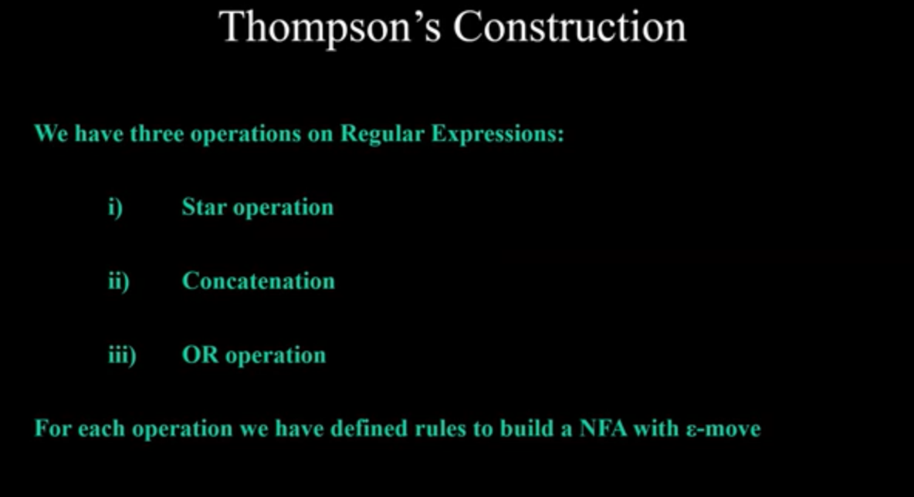

Slide 27
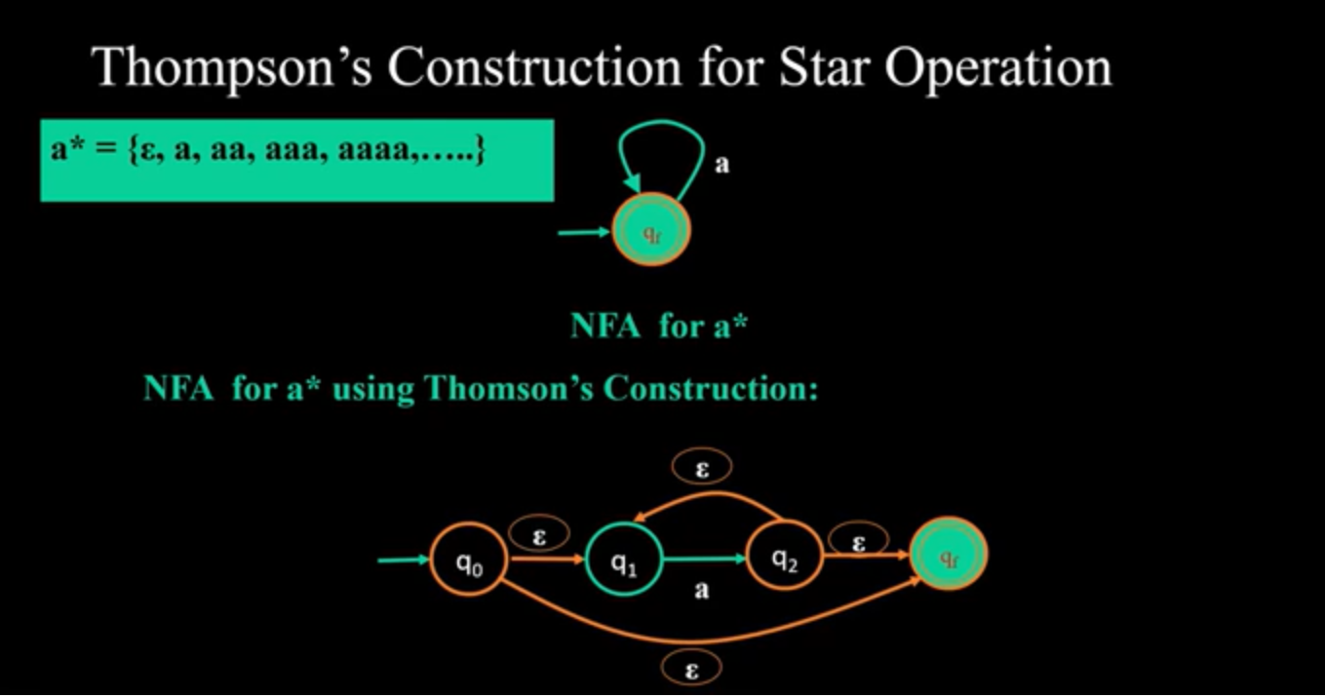
Example: a(bc)*

Slide 28
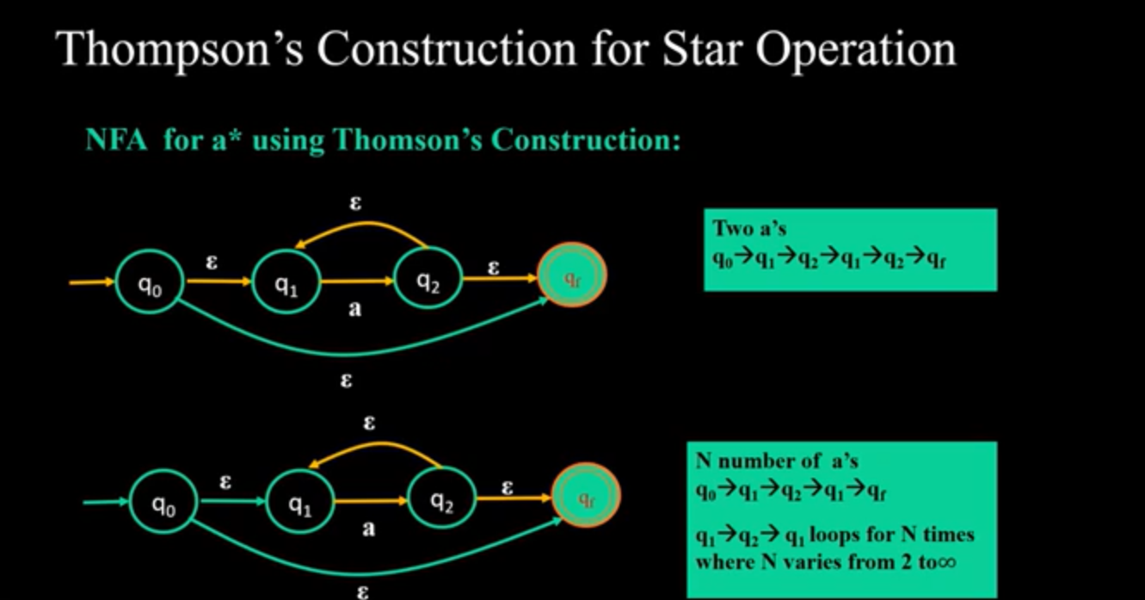

Slide 29
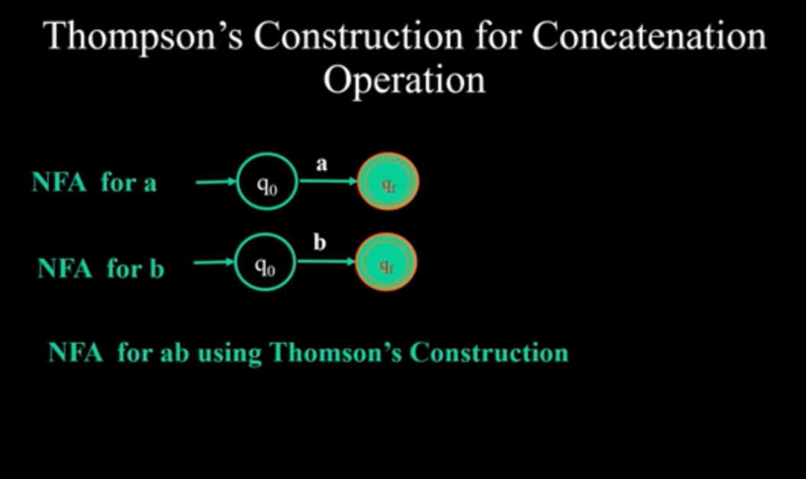

Slide 30
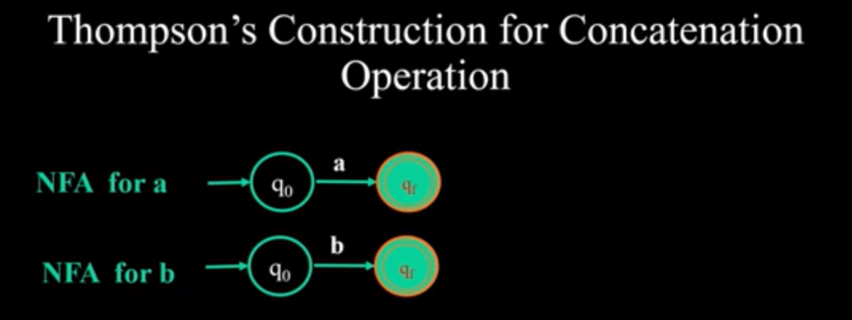

Slide 31
(ab)
b
q3
ɛ
q1
a
q2
ɛ
q3
q0

Slide 32
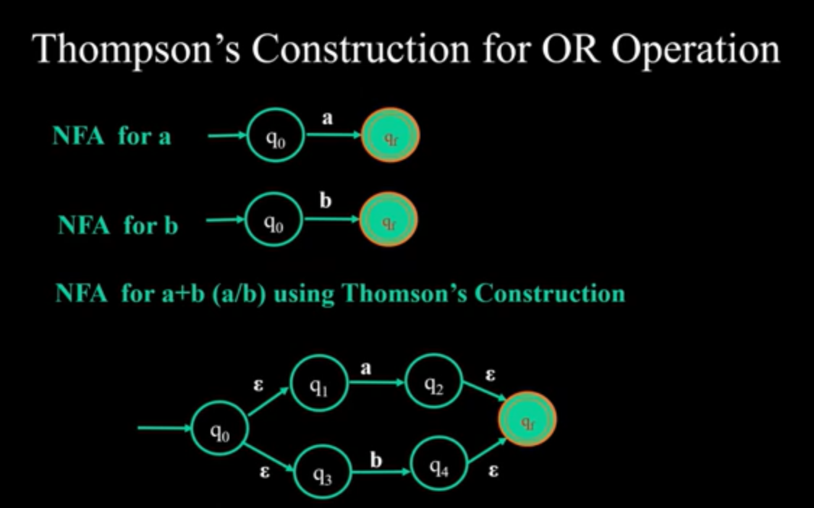

Slide 33
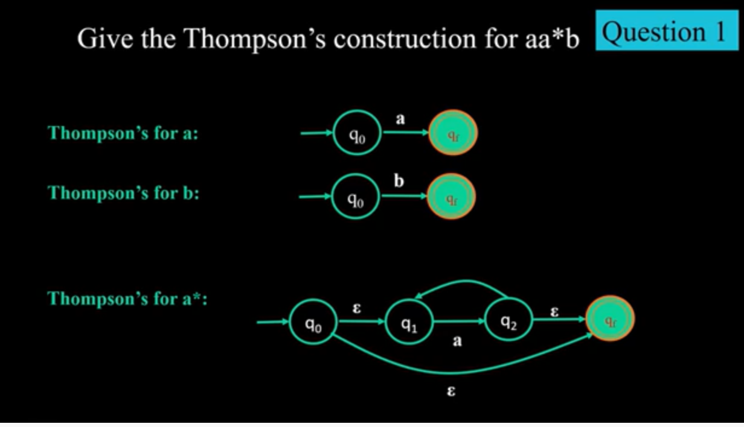

Slide 34
aa*b
ɛ
ɛ
ɛ
a
ɛ
ɛ
b
qf
qi
ɛ
q3
a
q4
q0
q1
q2
q5
q6
ɛ

Slide 35
Example: a (b | c)*d
ɛ
b
ɛ
ɛ
ɛ
b
ɛ
a
ɛ
ɛ
ɛ
ɛ
c
ɛ

Slide 36
Source:
https://www.youtube.com/watch?v=upu_TeZImN0
https://www.youtube.com/watch?v=DryssBQeOaM
https://www.tutorialspoint.com/

